Slide 1
Dream Cake Wonderland
Submitted By-
Priyanka Kenjale. 210943120040 Sheetal Solanke. 210943120089 Shubhangi Shinde. 210943120101 Priyanka Takale. 210943120108

Slide 2
OBJECTIVE-
Provide platform to Home makers to sell their product.
To provide customize cakes as per the customers requirement and others bakery goods like confectionary , readymade cakes and decoration item.

Slide 3
Requirement Specification
Hardware:
1. Intel i3 processor 3rd generation or above
2. 2 GB ram.
3. Windows 7 Home edition or later.
4. 200 GB HDD Space
5. Data Connection 200 Kbps
Software:
Eclipse EE 2020-21
MySQL 5.7 with Workbench 8.0
Google Chrome version 99.0
Apache Tomcat Server 8.5
Maven Dependencies

Slide 4
Introduction
Dream cake wonderland is cake shop with variety of services like customize cakes, readymade cakes confectionary and decoration items. Mainly aim to provide selling platform to home makers.
There are four modules in this project as below-
Admin
Cakeshops
Delivery man
customer

Slide 5
Admin can manages all the operations of cake shops and customer. He can add or remove the new employee such as cake shop and delivery man, can add product view stock report .
Customer needs to register first and then login. He can add product into cart and proceed further to confirm order
Cake shop needs to login first because they are added by admin. They can add ,view product They can assign placed order to self.
Delivery needs to login first, then he picked ready orders from cake shops for delivery ,and after delivery when he remark as delivers then the order status of customer is changed to delivered.

Slide 6
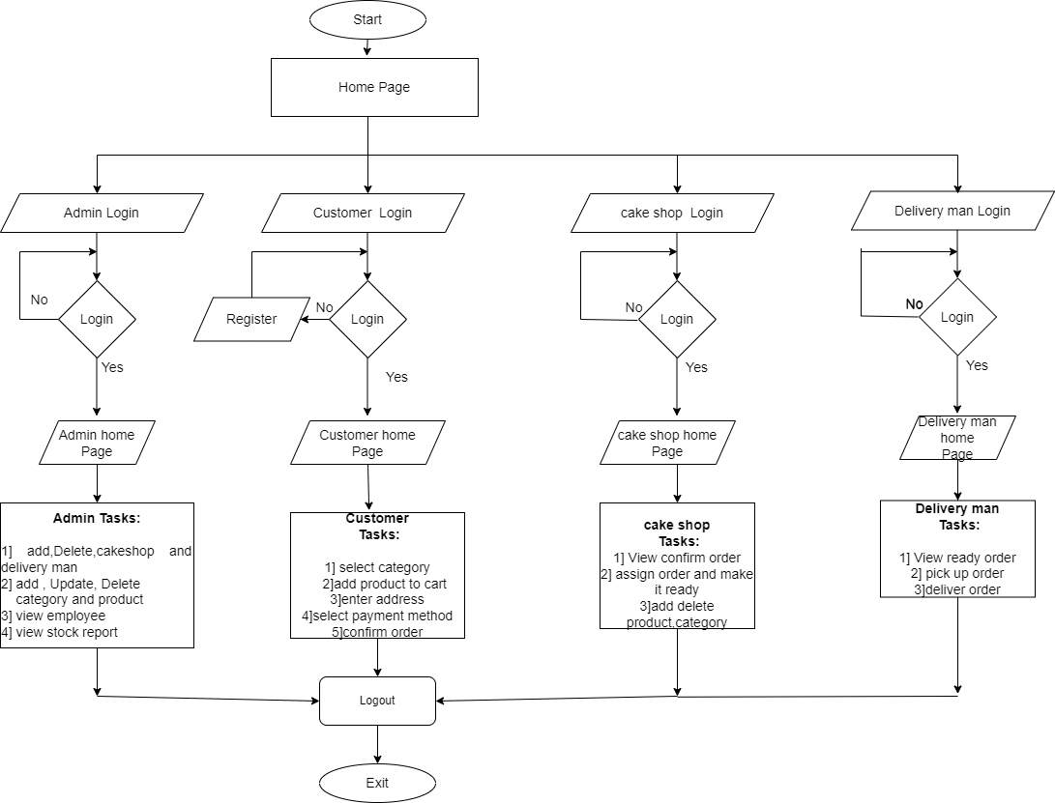
Flowchart

Slide 7
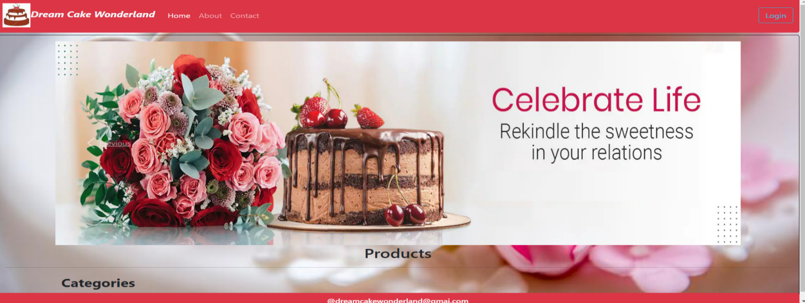
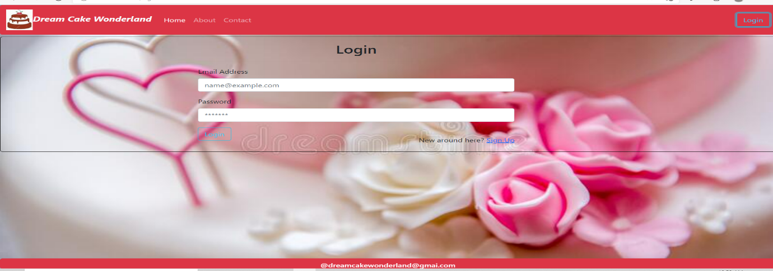
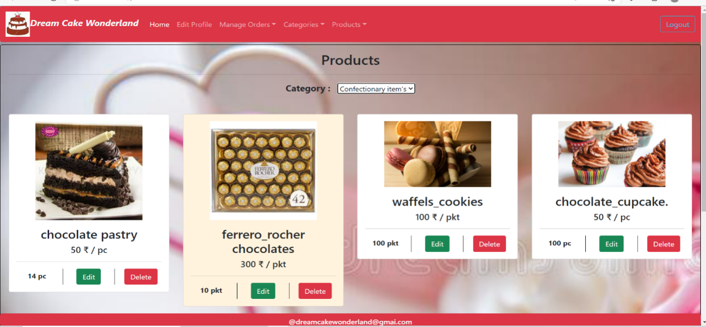
Screenshot of webpages

Slide 8
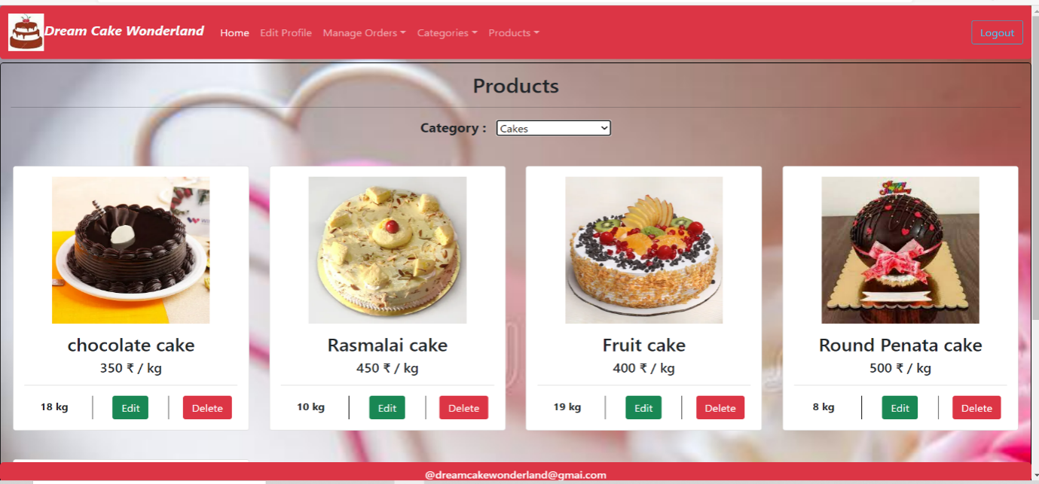
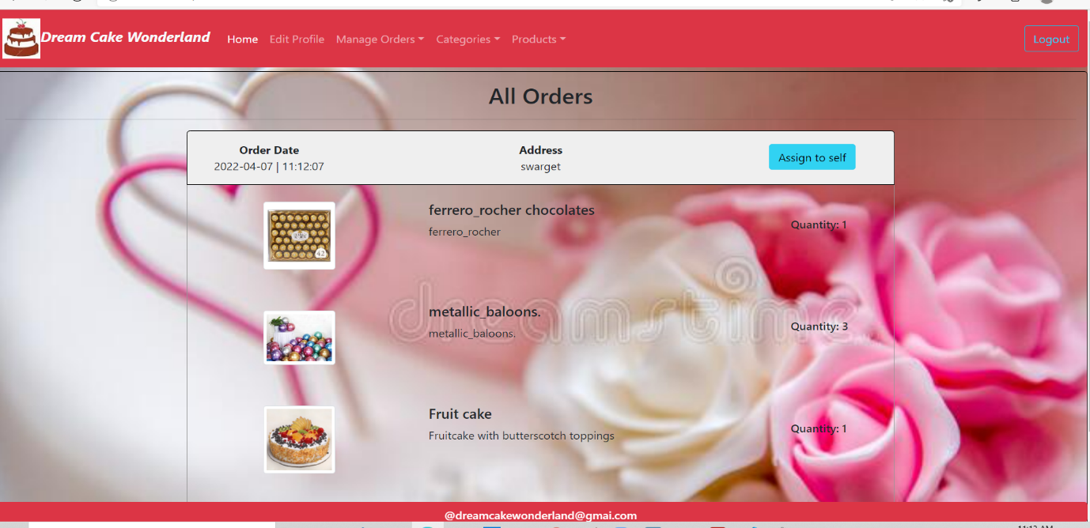
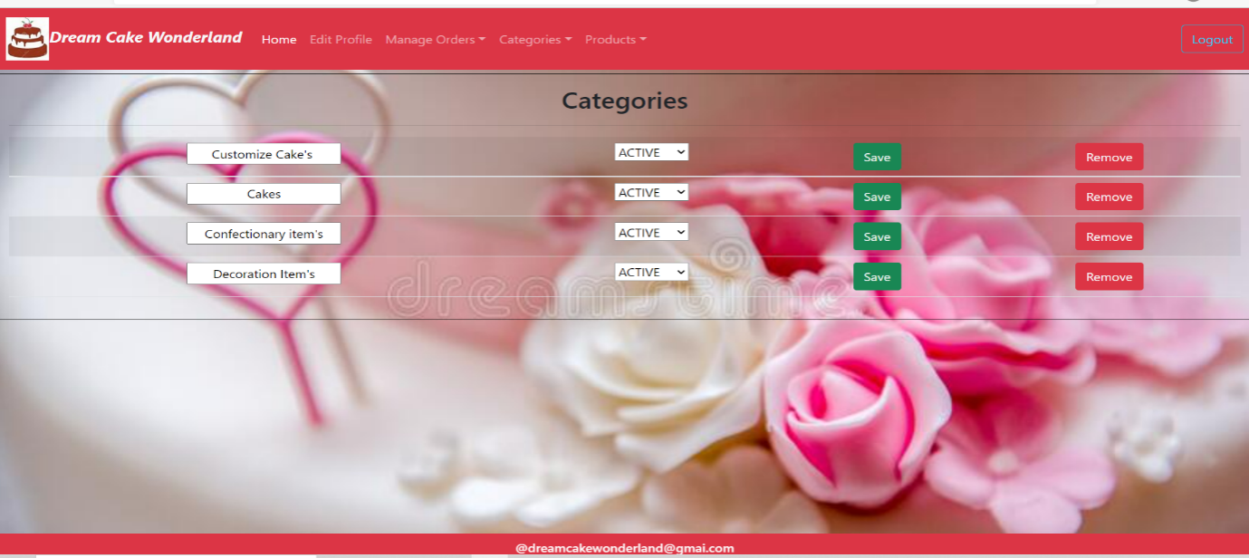
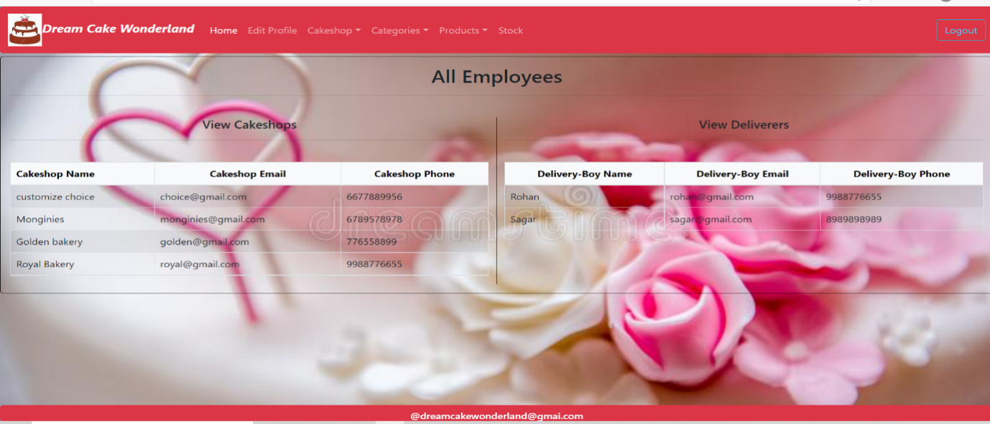

Slide 9
Future Scope
The future scope of the project is to provide Party Decorations sets with various type of gifts. Give virtual assessment to talk directly with cake shops regarding any help or any issues..

Slide 10
THANK YOU

